Slide 1
CENG 407 Project Presentation
Restaurant Revıews accordıng to geographıcal locatıon
BESTE ŞANKAYNAĞI 201711061
BARAN YİĞİT 201711071
ÇOŞKUN ORUÇ 201811046

Slide 2

Purpose
This Project is a project for helping users find good restaurants when they can't be so sure about what to eat or which restaurant they would like to go to. Main goal of our project is to help users find restaurants that suit user's tastes by getting tags from users with an easy to use application. Users could also help other users by giving reviews to restaurants they eat from and giving points to restaurants. Application will use Google Maps API to show restaurants by received range. This application would help users to find which restaurant they would like to eat at.

Slide 3
Introduction
This project sorts the restaurants around the users according to their scores and distance from the user, and shows other comments made to the chosen restaurant by the other users.
Thanks to this project, users will be able to access directions, comments and photos of the restaurant they want to go to, using the appropriate filtering features.
3 types of users can use this application. (Anonymous, admin, member)

Slide 4
Introduction
The project is a mobile-based application. The client-side application will be developed as an Android application.
Eclipse will be used as client side IDE to develop Android application.
Also, Java is the main programming language for developing Android applications in Eclipse. Android Studio will be used and Google libraries will be used.
In addition, Google's own database, primarily the Google API, will be used for the development of this project. The comments and information of the members will also be kept in the database we will create.

Slide 5
Related Works
Yemek Sepeti
Other users are unable to give feedback on user comments such as "helpful" or "not helpful".
It doesn't have GPS.
Tripadvisor
The main focus is not restaurants.
Zomato
No comment control.
Filtering features are limited (i.e. no range)
This site contains a lot of outdated information.
Users cannot add food or restaurant photos.

Slide 6
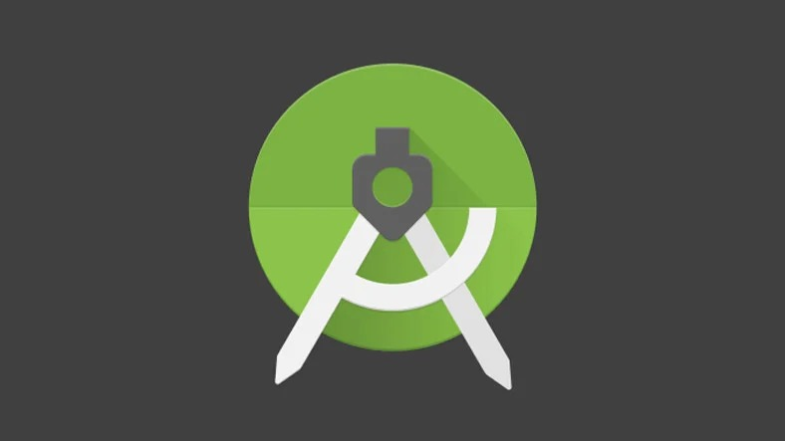
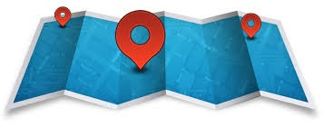
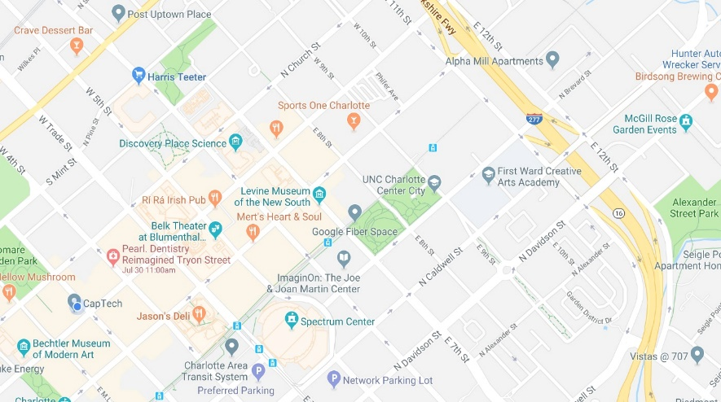

Background
Android Studio Location Data
Maps API System Database

Slide 7
Product Functions
Getting user position
Getting desired position
Creating a Map
Sending a mail
Update Restaurants / Reviews
CheckImage (Optional)
Authentication Services

Slide 8
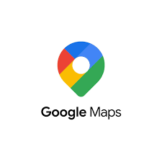
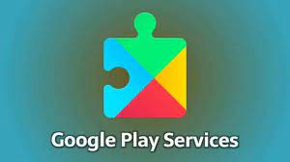

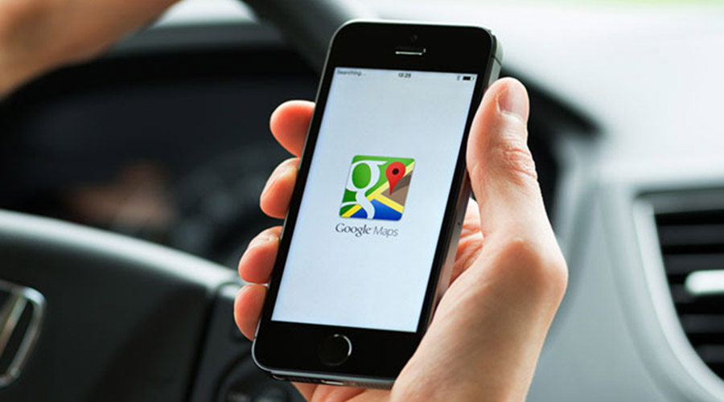
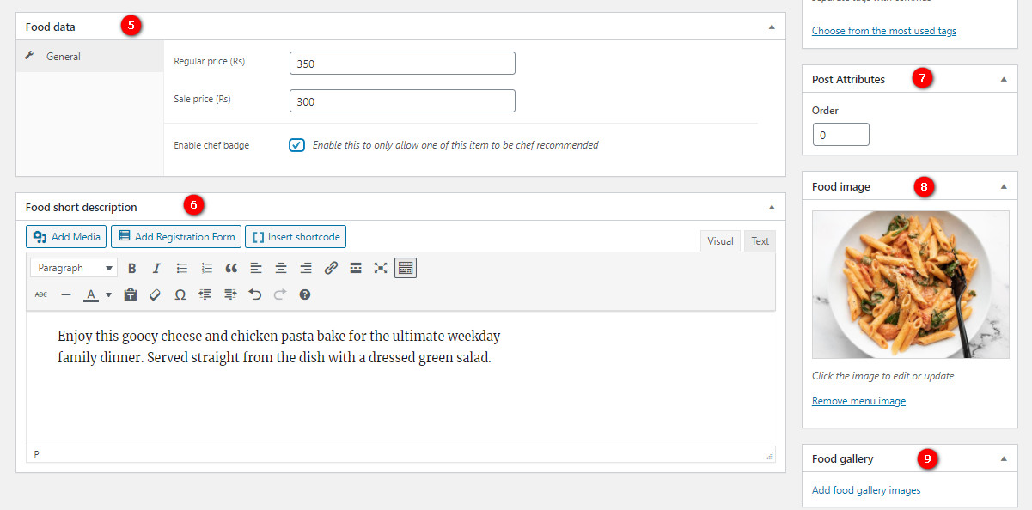
Assumptions

Slide 9
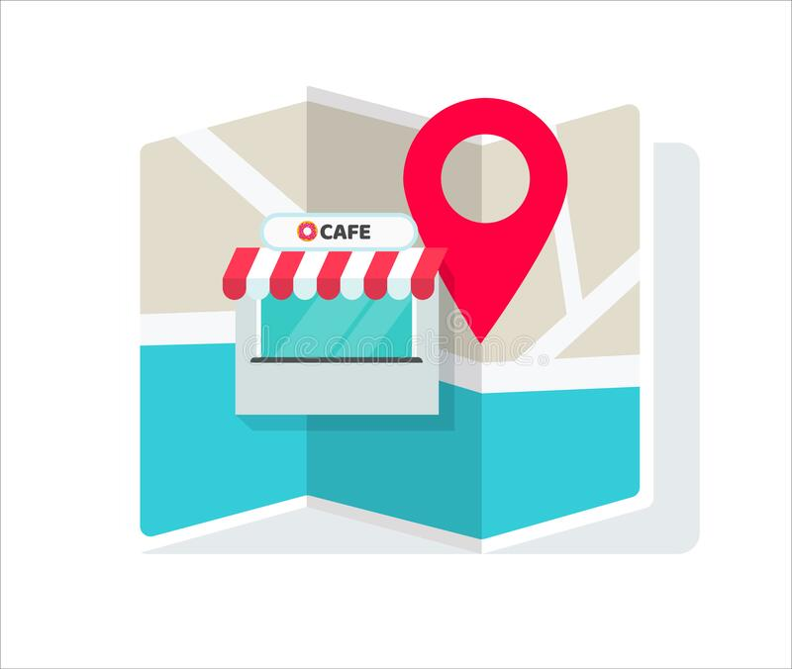

Dependencies

Slide 10
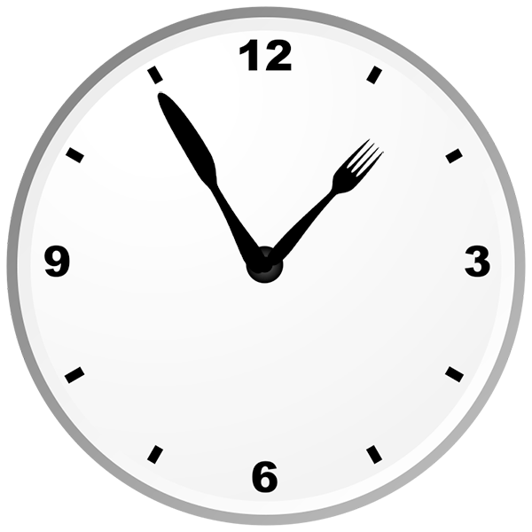
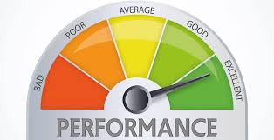
Constraints

Slide 11
Use Cases
Opening Page
Registration Page
Member Login Page
Admin Login
Anonymous Login
Adding to the blacklist
Filtering
Showing Restaurant Details
Reviewing Restaurants
Commenting And Rating
Deleting Reviews
GPS Services
Show Restaurants
Send To Restaurants

Slide 12
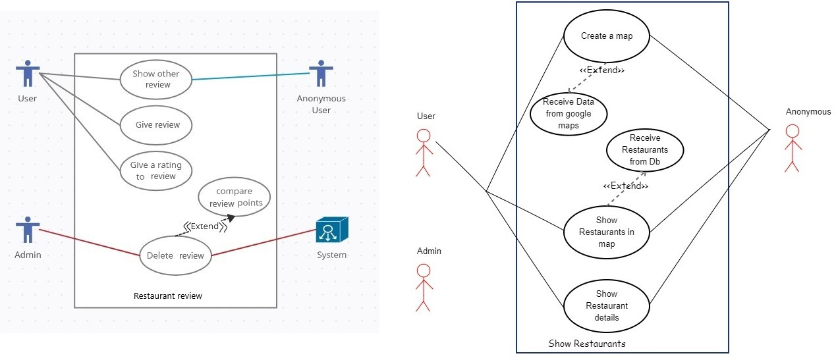
Use Cases

Slide 13
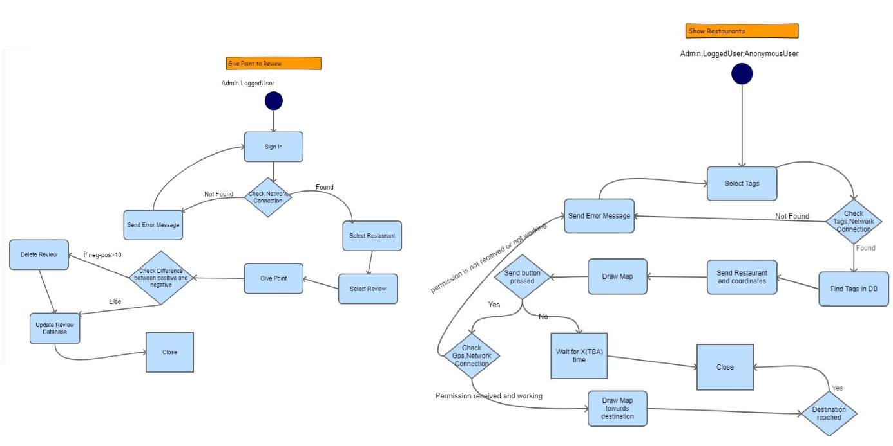
FlowCharts

Slide 14
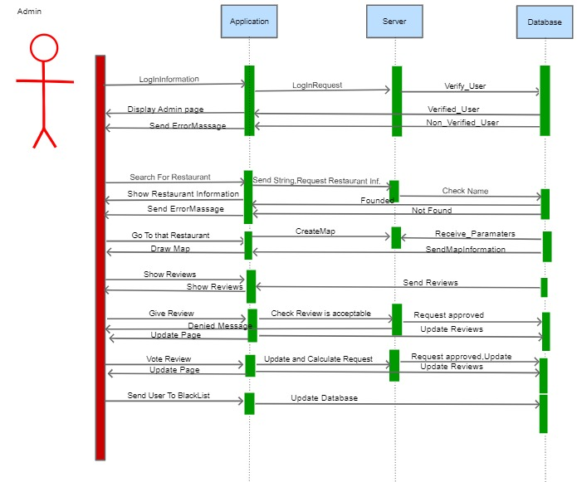
Sequence Diagrams

Slide 15
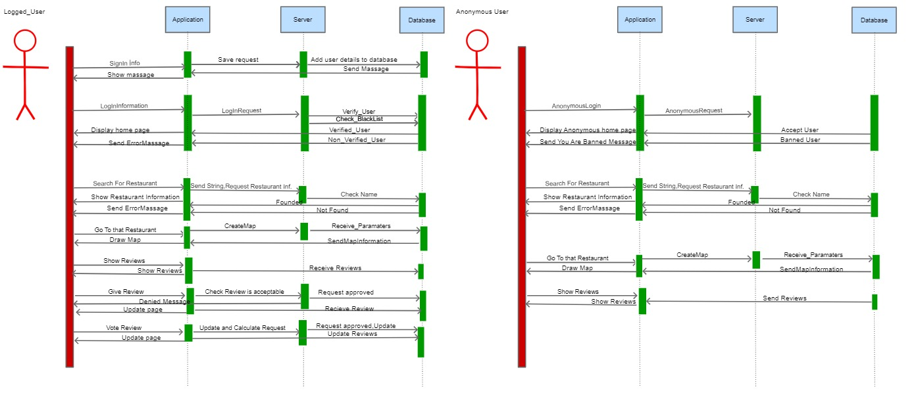
Sequence Diagrams

Slide 16
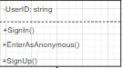
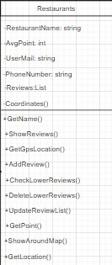
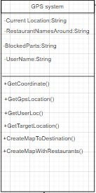
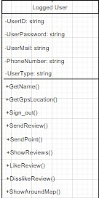
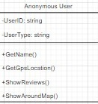
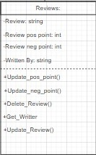
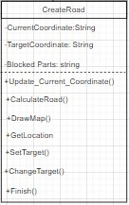
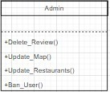
Class Diagram

Slide 17
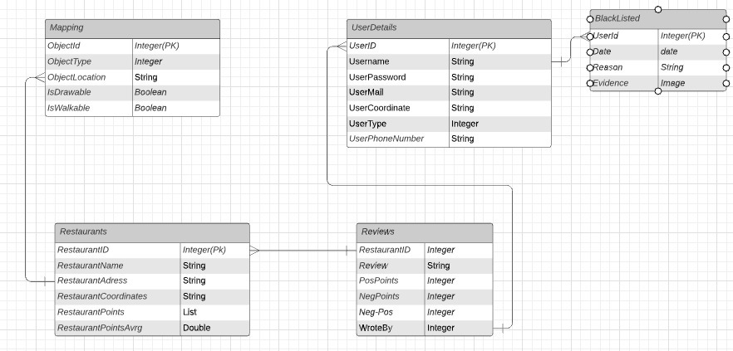
Database Diagram

Slide 18
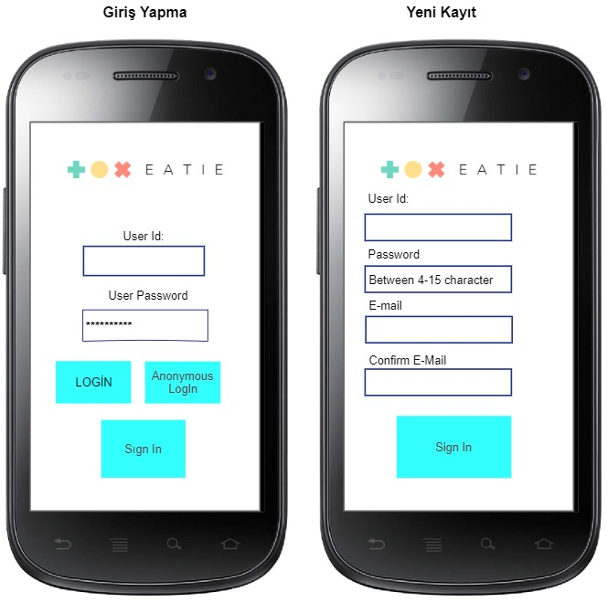
User Interfaces : Sign and Login

Slide 19
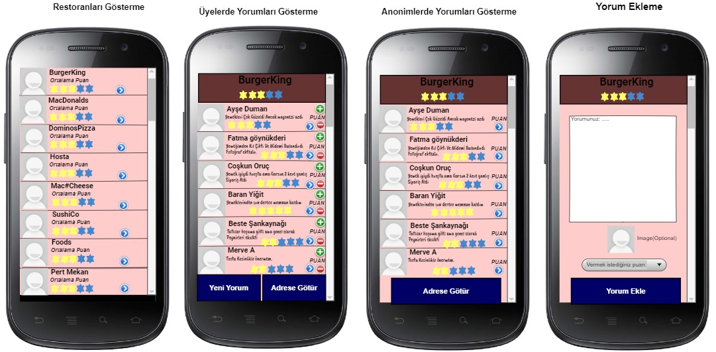
User Interfaces : Rating and Commenting

Slide 20
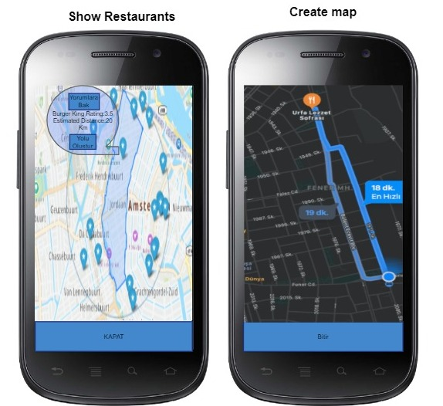
User Interfaces :GPS Systems

Slide 21
Thank you for listening to us.
QuESTIONS?

